Slide 2
Conservation Sanctuary
Conservation Cemetery

Slide 3
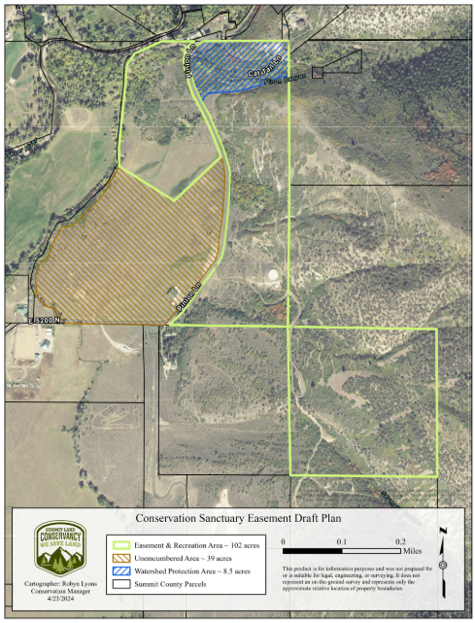
Conservation Burial area

Slide 4
Proposal
Creates cash flow for Oakley City
Creates a public access natural sanctuary
Preserves additional acreage for watershed protection
Preserves additional acreage for public trails
Management and stewardship is handled by Summit Land Conservancy rather than City staff

Slide 5
Conservation burial
Clean, safe, natural
Land restoration and enhancement
Available year round
Future facilities built and maintained by partners, as necessary and as approved by Oakley City

